Slide 1
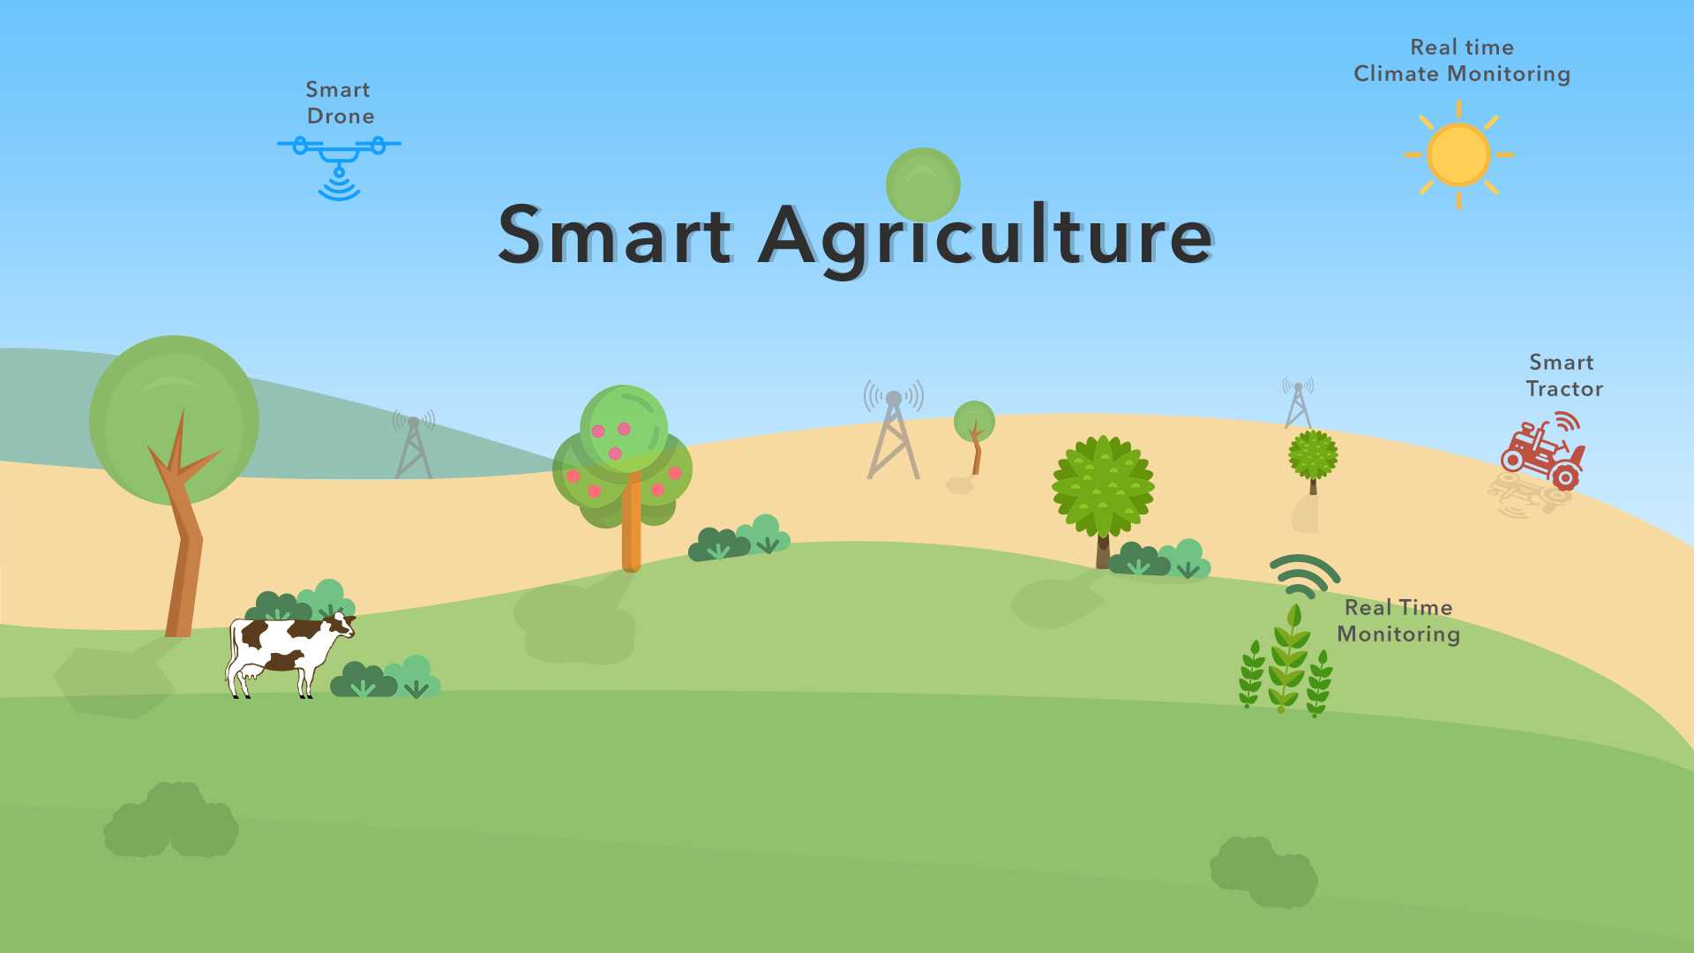

Slide 2
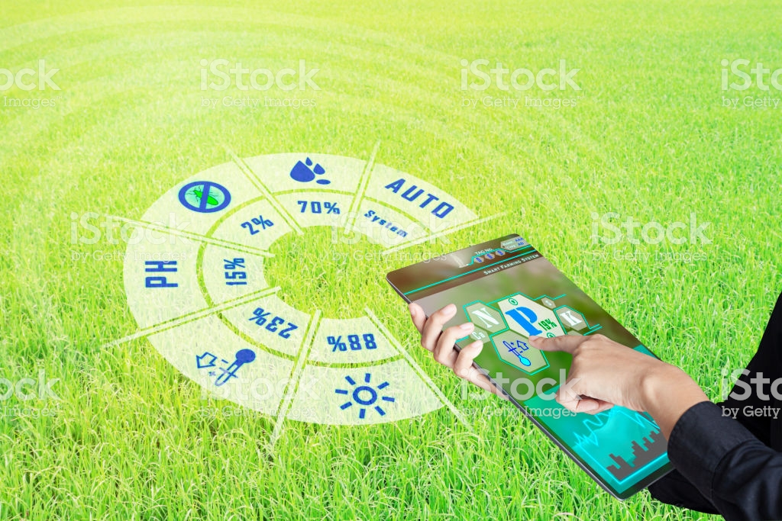
Content
NodeMCU
Temperature and humidity sensor
Soil moisture sensor
Rain sensor
Water pump motor

Slide 3
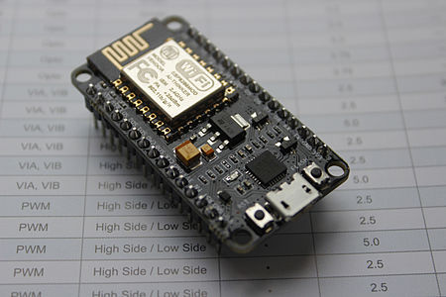
NodeMCU
The name "NodeMCU" combines "node" and "MCU"(micro-controller unit).
It is a type of single board microcontroller which as 128kb memory and 4mb of storage.
ESP8266 is a low-cost, Wi-Fi Module chip that can be configured to connect to the Internet for Internet of Things(IoT) and similar Technology Projects.
Basically, Your normal Electrical and Mechanical equipment's cannot connect to the Internet on their own. They don’t have the in-built setup to do so.
You can setup ESP8266 with these equipment's and do amazing stuff. Controlling, Monitoring, Analysis and much more.
NodeMCU is a Firmware on ESP8266. Its basically an SoC (System on Chip)
A System on a Chip or System on Chip(SoC) is an integrated circuit that integrates all components of a computer or other electronic systems.

Slide 4
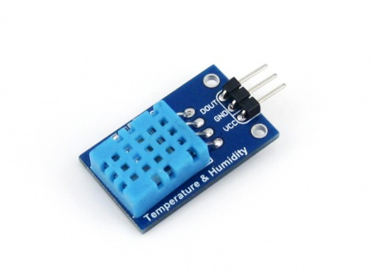
Temperature and humidity sensor
Temperature-Humidity Sensor is used to measure the temperature and humidity level in the agriculture field.
Sensor | DHT11 (Temperature & humidity sensor)
Operating voltage | 3.3V-5.5V
Humility measuring range | 20%-95%（0℃-50℃）
Humility measuring error | +-5%
Temperature measuring range | 0℃-50℃
Temperature measuring error | +-2℃
Dimensions | 29.0mm*18.0mm
Fixing hole size | 2.0mm

Slide 5
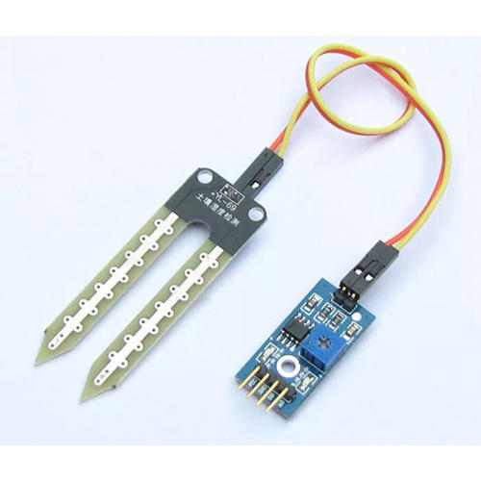
Soil moisture sensor
Measuring soil moisture is important for agricultural to help farmers manage their irrigation systems more efficiently. Knowing the exact soil moisture conditions on their fields, not only are farmers able to generally use less water to grow a crop, they are also able to increase yields and the quality of the crop by improved management of soil moisture during critical plant growth stages.

Slide 6
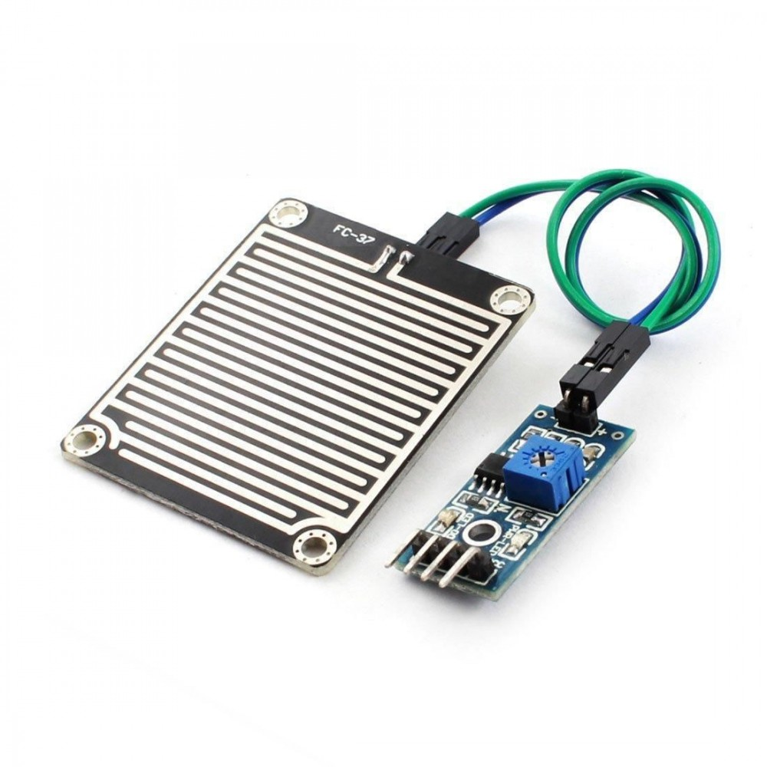
Rain sensor
A rain sensor is an automated device that shuts off your lawn irrigation system every time it rains. It is a relatively cheap device that can save up to 45 percent of your water bills, help protect the environment and conserve water.
A rain sensor is mounted outdoors away from trees and roof over hangs so that it can collect rainwater without obstruction. A rain sensor can either be wired or wirelessly attached into a lawn irrigation system.

Slide 7
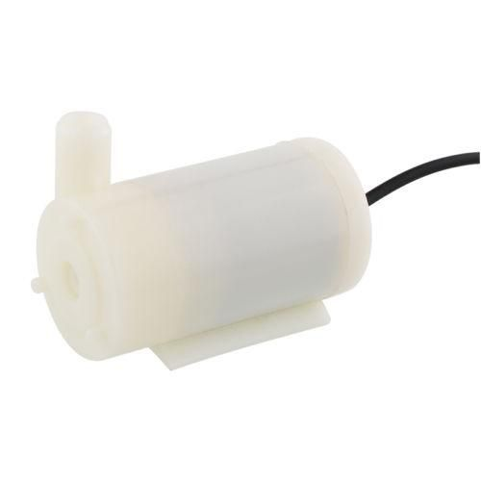
Water pump motor
water pump is a machine that delivers or pressurizes a liquid. It transfers the mechanical energy of the prime mover or other external energy to the liquid, increasing the energy of the liquid.
While mini water motor pump is mini type to transfer water from lower place to higher place or to far place.
It can be operated from a 3 ~ 6V power supply.
It can take up to 120 liters per hour with very low current consumption of 220mA.
Make sure that the water level is always higher than the motor. Dry run may damage the motor due to heating and it will also produce noise.

Slide 8

Thank you

